Slide 1

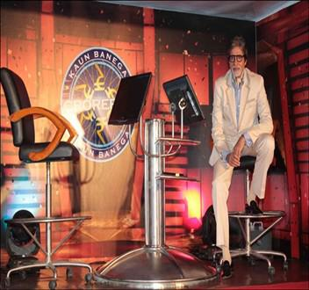
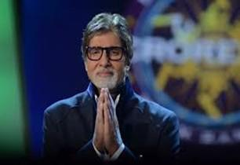
Welcome to kaun Banega Crorepati show

Slide 2
Rules of Kaun Banega Crorepati
** This is a powerpoint presentation which has the questions of KBC.
** Every questions will have 4 options from which only 1 will be correct.
**The questions have no time limit.
**There will be only 3 lifelines:50-50,Audience Poll and End Game.
**It needs a password to open the project at the beginning of the game.
**It has 15 stages.After then the game is over.
**by winning stage 4;stage 8 & stage 12you will get amount 40,000;6,40,000 & 2,04,80,000.
**This is only a game and the winner will be not taken as a contestant of KBC under any circumstances.
**If you see that your answer is right then enter your choice .

Slide 3
Purpose of KBC Game
This game is made only for entertainment.
This game enriches your general knowledge.
It will also help you to increase your potentiality.
This game will make people become a Billionaire.
This game can change one’s fortune.

Slide 4


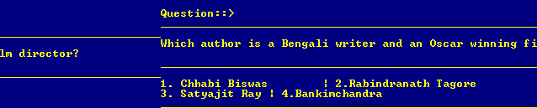
Here is the question for you

Slide 5

The game continues……

Slide 6
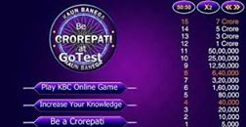
Here’s the 15 stages

Slide 7
Project Discription
# Namespace : Initially there are only namespace here “shah” here I keep My all game related data and functions that they don’t collids with other functions.
# Getter Setter : In vector and other classes we need getter setter function to access data.

Slide 8
Project Discription
# File : To save all players record it has used a file to store them and reading file it has made leaderboard from file .
# Class and Object : There are several classes and objects for Game,Driver,Vectorsubject .
# Constructor & Destructor: In game class it has used parameterised constructor,destructor
and also used Dynamic Memory Alloaction here .

Slide 9
Project Discription
# Dynamic memory allocation : In Learn/practice sector there used dynamic memory allocation in matrix .
# Operator Overloading : In game and vector section there used several type of operator overloading .
# getline() after cin: After finishing the game players are required to submit
Results statistics is saved to form a ranking table so that everyone can evaluate their position and progress . Leaderboard can help to be more competitive .

Slide 10
Project Discription
# Template :I made a template typr vector as it is flexiable with any software
# STL :I used string and functions from STL
# Functor & Lambda Function :I used lamda function in while sorting the array.

Slide 11
Project Discription
# Inheritance : It has inheritance as derived class is drive and base class is game

Slide 12
Thank
You!!

